Slide 1
Data modeling and partitioning in Azure Cosmos DB

Slide 2
Session's objectives
Understand how Cosmos DB differs from relational databases
Get familiar with NoSQL concepts
Learn NoSQL data modeling techniques and technologies used
Apply them to a real-world scenario

Slide 3
What is Azure Cosmos DB?
Microsoft's NoSQL database on Azure
Non-relational and
horizontally scalable

Slide 4



What is Azure Cosmos DB?
horizontally scalable
Unlimited throughput
Unlimited storage capacity

Slide 5

What is Azure Cosmos DB?
non-relational

Slide 6
What is Azure Cosmos DB?
non-relational
and horizontally scalable

Slide 7
So is Cosmos DB suitable for relational workloads?
It sure is!
Most workloads in Cosmos are actually relational
Different techniques used to implement relationships
Not intuitive. Relational best practices don't translate well and may even be anti-patterns!

Slide 8
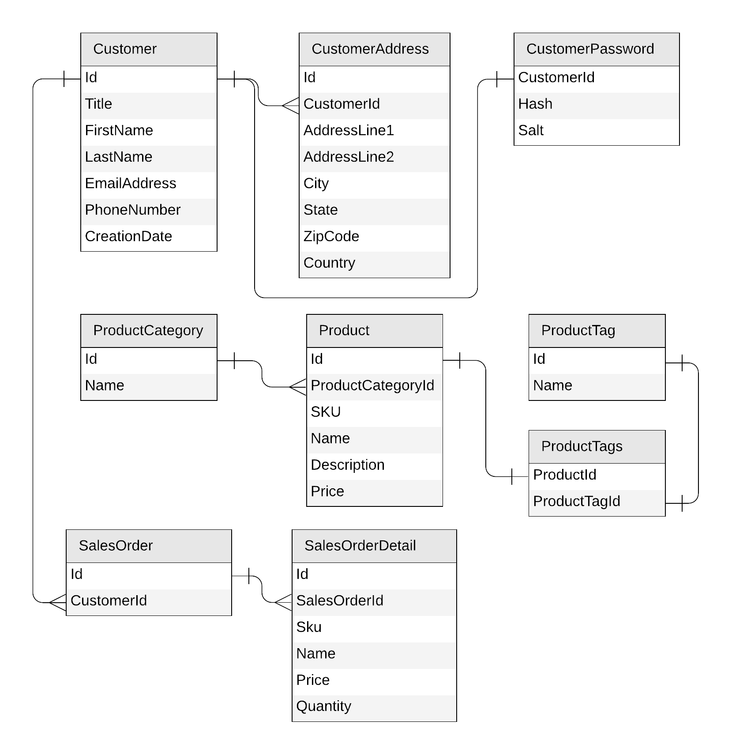
Let's look at a concrete example
E-commerce workload
Customers
Products
Categories
Tags
Sales Orders

Slide 9
Identifying the operations for our app
Create a customer
Edit a customer
Retrieve a customer
Create a product category
Edit a product category
List all product categories
Create a product tag
Edit a product tag
List all product tags
Create a product
Edit a product
List all products from a category (with name of category)
Create a sales order
List all sales order for a customer
Query top 10 customers by number of sales orders

Slide 10
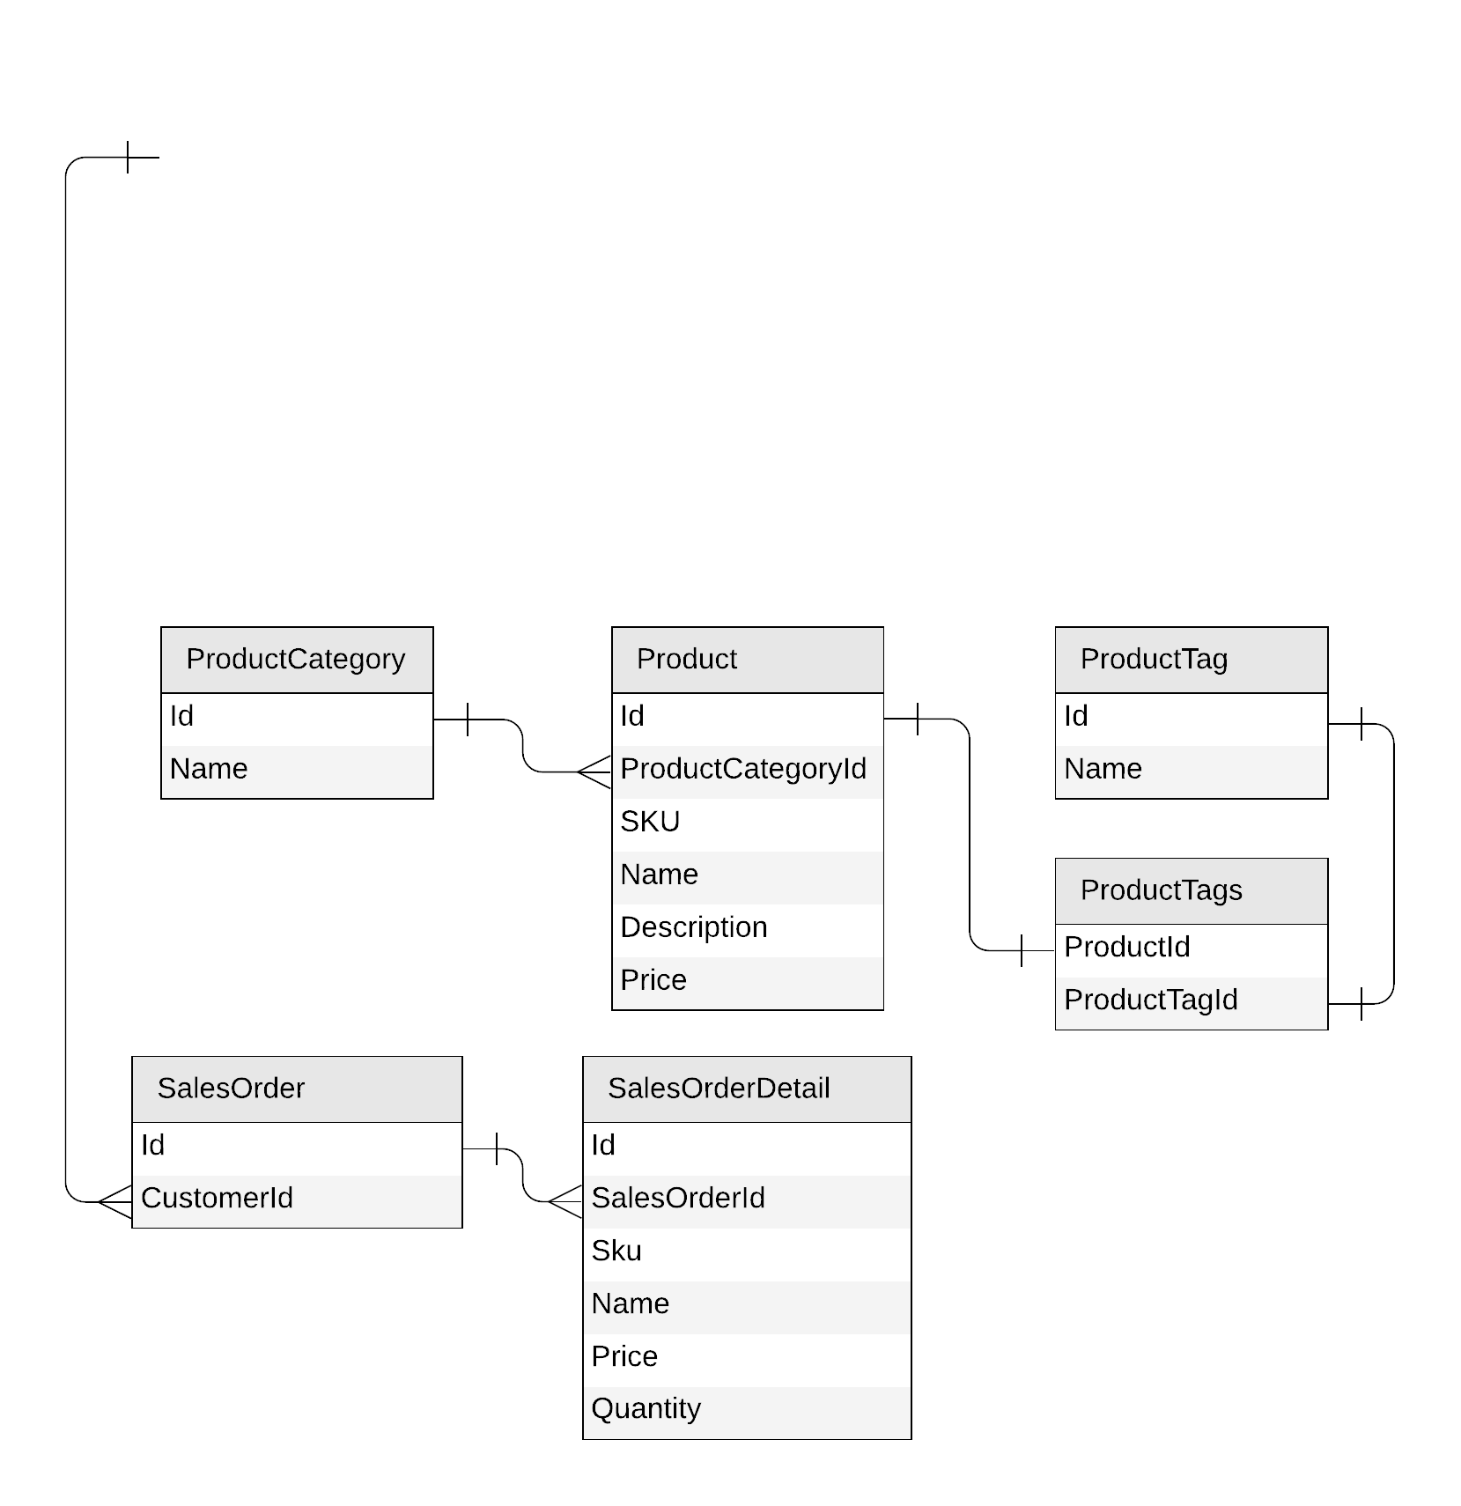
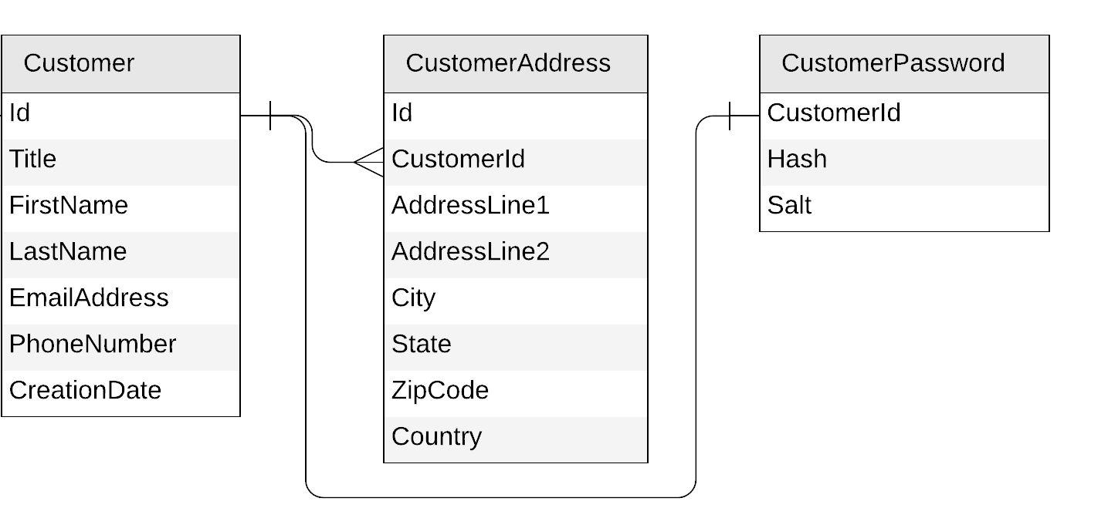
Let’s get started!

Slide 11
Starting with the Customer entity
Create a customer
Edit a customer
Retrieve a customer
{
"id": "…",
"title": "…",
"firstName": "…",
"lastName": "…",
"emailAddress": "…",
"phoneNumber": "…",
"creationDate": "…"
}
{
"id": "…",
"customerId": "…",
"addressLine1": "…",
"addressLine2": "…",
"city": "…",
"state": "…",
"zipCode": "…",
"country": "…"
}
{
"id": "…",
"customerId ": "…",
"hash": "…",
"salt": "…"
}

Slide 12
Starting with the Customer entity
{
"id": "…",
"title": "…",
"firstName": "…",
"lastName": "…",
"emailAddress": "…",
"phoneNumber": "…",
"creationDate": "…",
"addresses": [{
"addressLine1": "…",
"addressLine2": "…",
"city": "…",
"state": "…",
"zipCode": "…",
"country": "…"
}],
"password": {
"hash": "…",
"salt": "…"
}
}

Slide 13
To embed or to reference?
{
"id": "…",
"title": "…",
"firstName": "…",
"lastName": "…",
"emailAddress": "…",
"phoneNumber": "…",
"creationDate": "…",
"addresses": [{
"addressLine1": "…",
"addressLine2": "…",
"city": "…",
"state": "…",
"zipCode": "…",
"country": "…"
}],
"password": {
"hash": "…",
"salt": "…"
}
}
{
"id": "…",
"title": "…",
"firstName": "…",
"lastName": "…",
"emailAddress": "…",
"phoneNumber": "…",
"creationDate": "…"
}
{
"id": "…",
"customerId": "…",
"addressLine1": "…",
"addressLine2": "…",
"city": "…",
"state": "…",
"zipCode": "…",
"country": "…"
}
{
"id": "…",
"customerId ": "…",
"hash": "…",
"salt": "…"
}

Slide 14
To embed or to reference?
Embed when:
1:1 relationship
1:few relationship
Related items are queried or updated together
Reference when:
1:many relationship (especially if unbounded)
Many:many relationship
Related items are queried or updated independently

Slide 15
Our first entity: Customer
{
"id": "…",
"title": "…",
"firstName": "…",
"lastName": "…",
"emailAddress": "…",
"phoneNumber": "…",
"creationDate": "…",
"addresses": [{
"addressLine1": "…",
"addressLine2": "…",
…
}],
"password": {
"hash": "…",
"salt": "…"
}
}

Slide 16
Customer
{
"id": "…",
"title": "…",
"firstName": "…",
"lastName": "…",
"emailAddress": "…",
"phoneNumber": "…",
"creationDate": "…",
"addresses": [{
"addressLine1": "…",
"addressLine2": "…",
…
}],
"password": {
"hash": "…",
"salt": "…"
}
}
customer
PK: ?

Slide 17
What is partitioning?

Slide 18

What is partitioning?
logical partitions

Slide 19
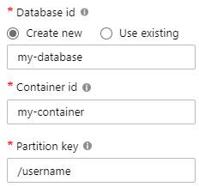
What is partitioning?
Andrew
Thomas
Deborah
Tim
Mark
Theo

Slide 20
What is partitioning?
Max size: 2 MB
Max size: 20 GB

Slide 21

What is partitioning?

Slide 22
What is partitioning?

Slide 23
What is partitioning?

Slide 24

What is partitioning?
Andrew
Deborah
Tim
Mark
Thomas
Theo
SELECT * FROM c WHERE c.username = 'Mark'
our partition key

Slide 25
What is partitioning?
Andrew
Deborah
Tim
Mark
Luis
Theo
SELECT * FROM c WHERE c.favoriteColor = 'orange'
?

Slide 26
Choosing a partition key for customers
{
"id": "…",
"title": "…",
"firstName": "…",
"lastName": "…",
"emailAddress": "…",
"phoneNumber": "…",
"creationDate": "…",
"addresses": [{
"addressLine1": "…",
"addressLine2": "…",
…
}],
"password": {
"hash": "…",
"salt": "…"
}
}
customer
PK: ?

Slide 27
Choosing a partition key for customers
customer
PK: ?
Create a customer
Edit a customer
Retrieve a customer
(by id)

Slide 28
Choosing a partition key for customers
customer
PK: id
Create a customer
Edit a customer
Retrieve a customer
(by id)

Slide 29
Choosing a partition key for customers
customer
PK: id

Slide 30
Demo
Query customers

Slide 31
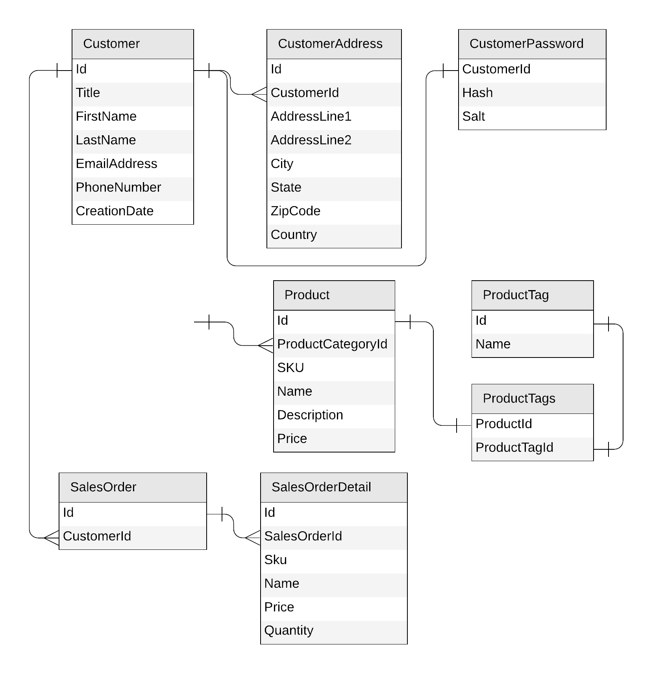
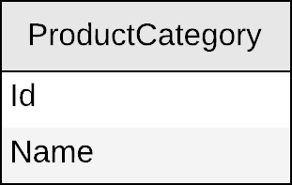
Next: products

Slide 32
Product category
{
"id": "…",
"name": "…"
}

Slide 33
Product category
productCategory
PK: ?
{
"id": "…",
"name": "…"
}

Slide 34
Product category
productCategory
PK: ?
Create a product category
Edit a product category
List all product categories
SELECT * FROM c

Slide 35
Product category
productCategory
PK: type
{
"id": "…",
"name": "…",
"type": "category"
}
SELECT * FROM c WHERE
c.type = “category”

Slide 36
Demo
Query product categories

Slide 37
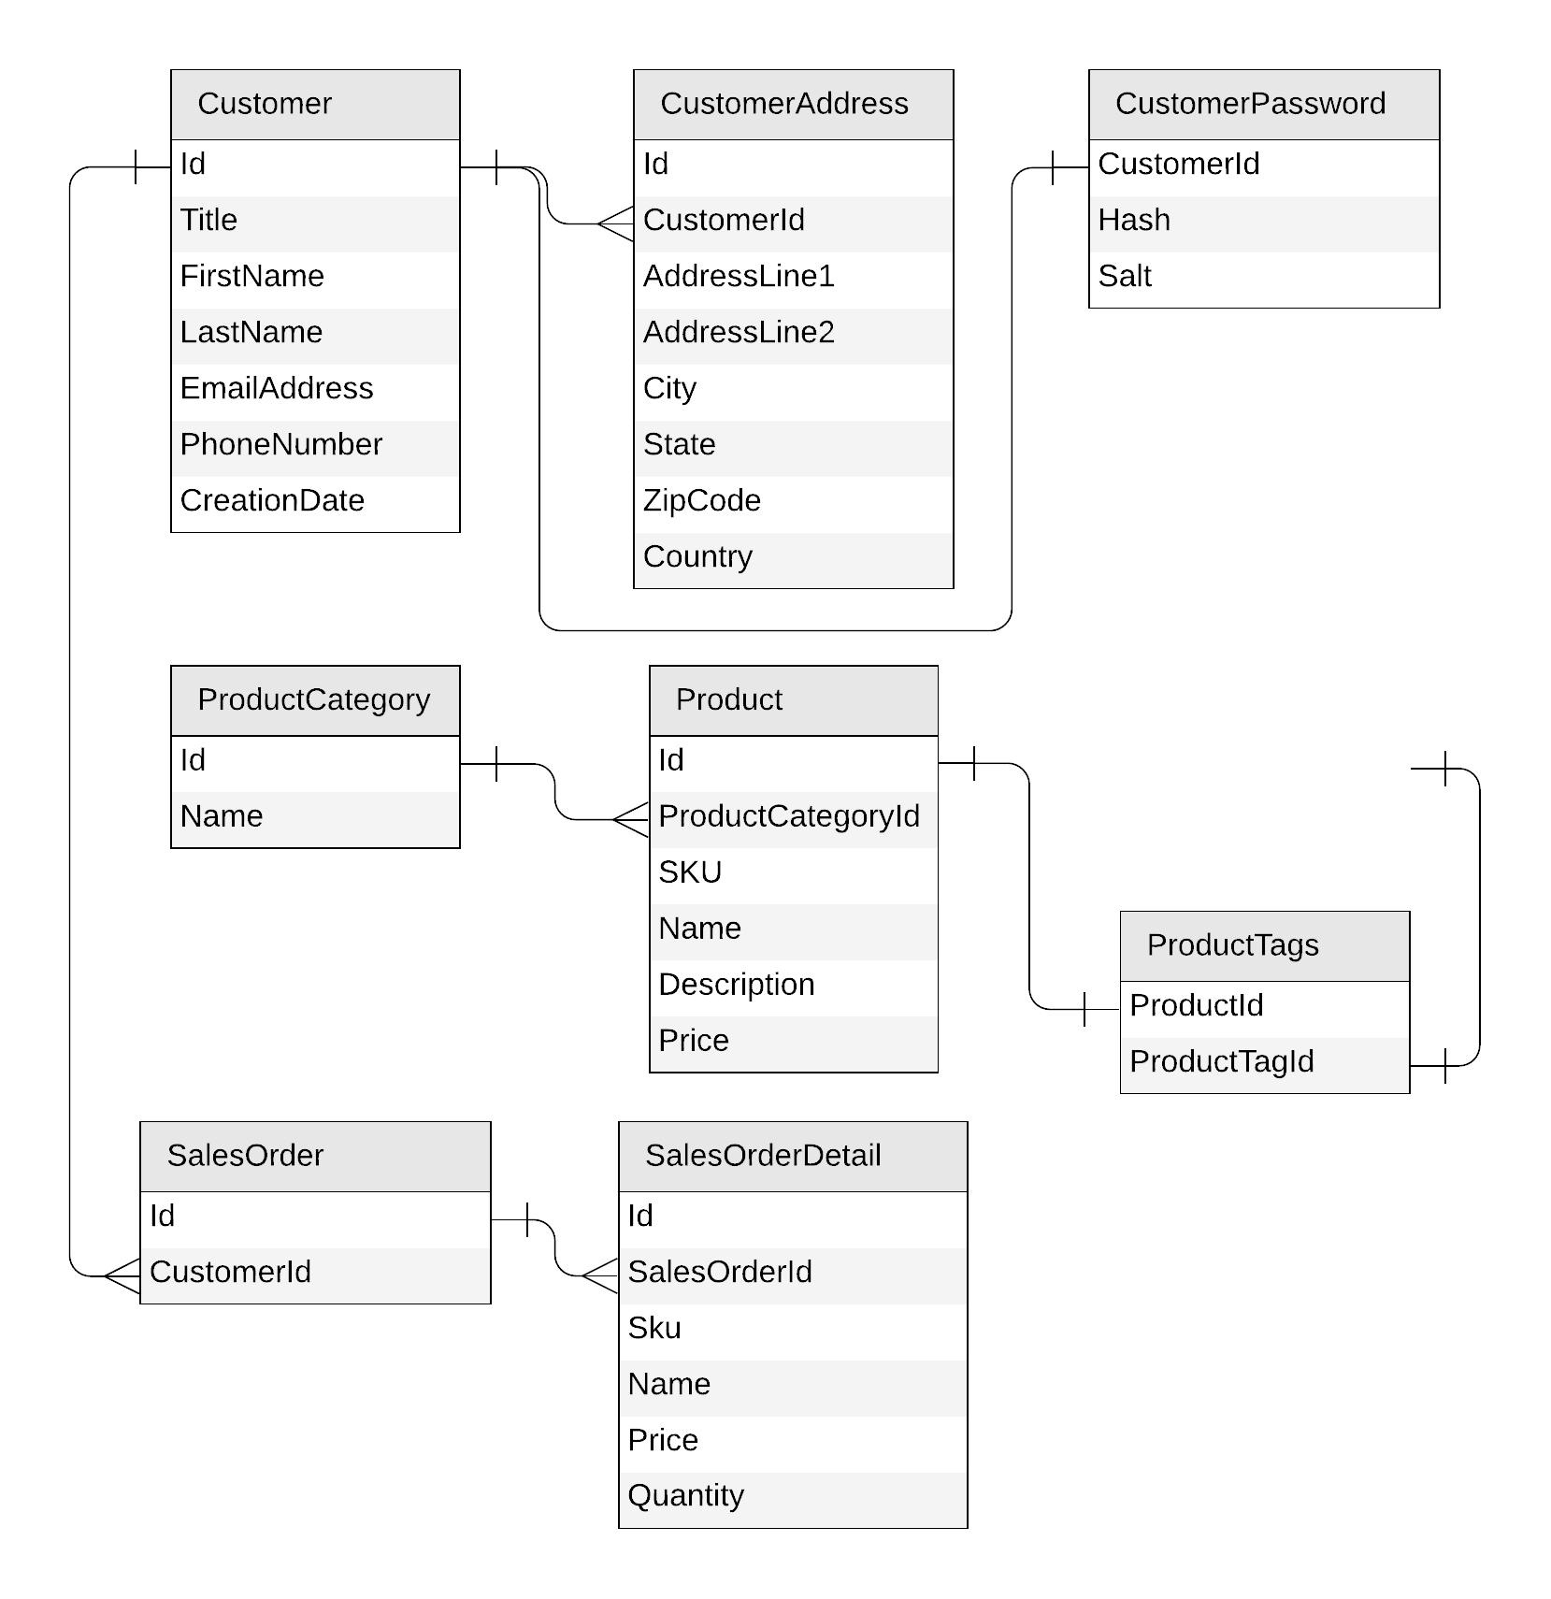
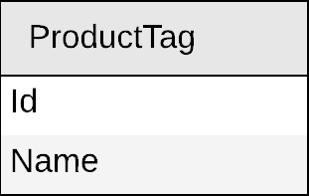
Next: product tag

Slide 38
Product tag
{
"id": "…",
"name": "…"
}

Slide 39
Product tag
productTag
PK: ?
{
"id": "…",
"name": "…"
}

Slide 40
Product tag
productTag
PK: ?
Create a product tag
Edit a product tag
List all product tags

Slide 41
Product tag
productTag
PK: type
{
"id": "…",
"name": "…",
"type": "tag"
}

Slide 42
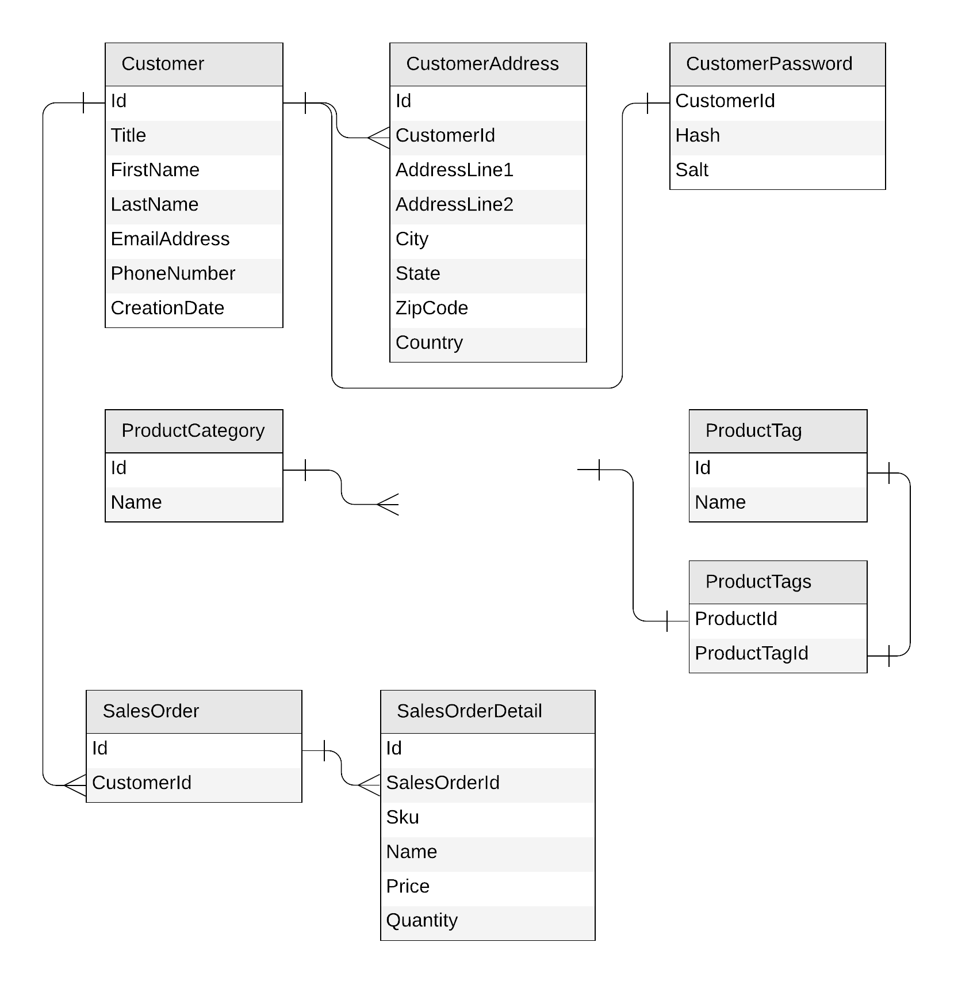
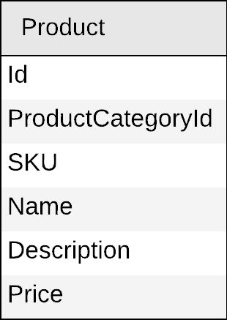
Next: product

Slide 43
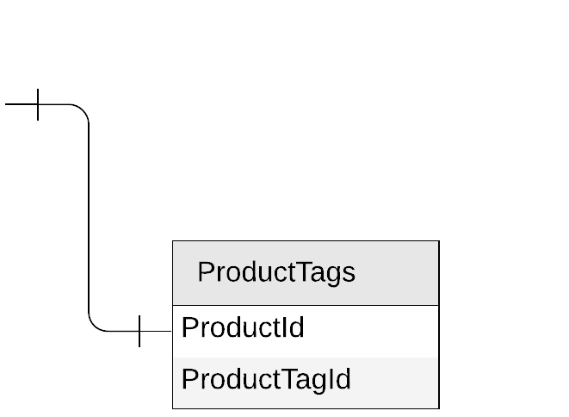
Product
{
"id": "…",
"categoryId": "…",
"sku": "…",
"name": "…",
"description": "…",
"price": …
}

Slide 44
Products
{
"id": "…",
"categoryId": "…",
"sku": "…",
"name": "…",
"description": "…",
"price": …,
"tagIds": [
"…",
"…"
]
}

Slide 45
Products
{
"id": "…",
"categoryId": "…",
"sku": "…",
"name": "…",
"description": "…",
"price": …,
"tagIds": [
"…",
"…"
]
}
product
PK: ?

Slide 46
Products
Create a product
Edit a product
List all products from a category (with name of category and tags)
product
PK: ?
SELECT * FROM c WHERE c.categoryId = 'CategoryA'
CategoryA
CategoryB
CategoryC

Slide 47
Products
{
"id": "…",
"categoryId": "…",
"sku": "…",
"name": "…",
"description": "…",
"price": …,
"tagIds": [
"…",
"…"
]
}
category name?
product
PK: categoryId
tag names?

Slide 48

Products: how to return category and tag names?
product
SELECT * FROM c WHERE c.categoryId = 'CategoryA'
WHERE ARE MY JOINS?
productCategory
SELECT c.name FROM c WHERE c.id = 'CategoryA'
productTag
SELECT * FROM c
WHERE c.id IN ('<tagId1>', '<tagId2>', '<tagId3>')

Slide 49
Introducing denormalization
When working with non-relational databases, we optimize our data models to make sure that all the required data is ready to be served by the queries

Slide 50
Products: denormalizing category and tag names
{
"id": "…",
"categoryId": "…",
"categoryName": "…",
"sku": "…",
"name": "…",
"description": "…",
"price": …,
"tags": [
{
"id": "…"
"name": "…"
},
{
"id": "…"
"name": "…"
},
]
}
product
PK: categoryId

Slide 51
Demo
Query a product with category name and tag names

Slide 52
Products: keeping everything in sync
productCategory
ProductCategory
product
Product
productTag
ProductTag

Slide 53

Cosmos DB's change feed
The change feed is an API exposed by Cosmos DB containers
It streams any change happening in a container (document creation or update)

Slide 54

Products: keeping everything in sync
productCategory
product
productTag

Slide 55
Demo
Update product category name
Use Change Feed to propagate the change into product container

Slide 56
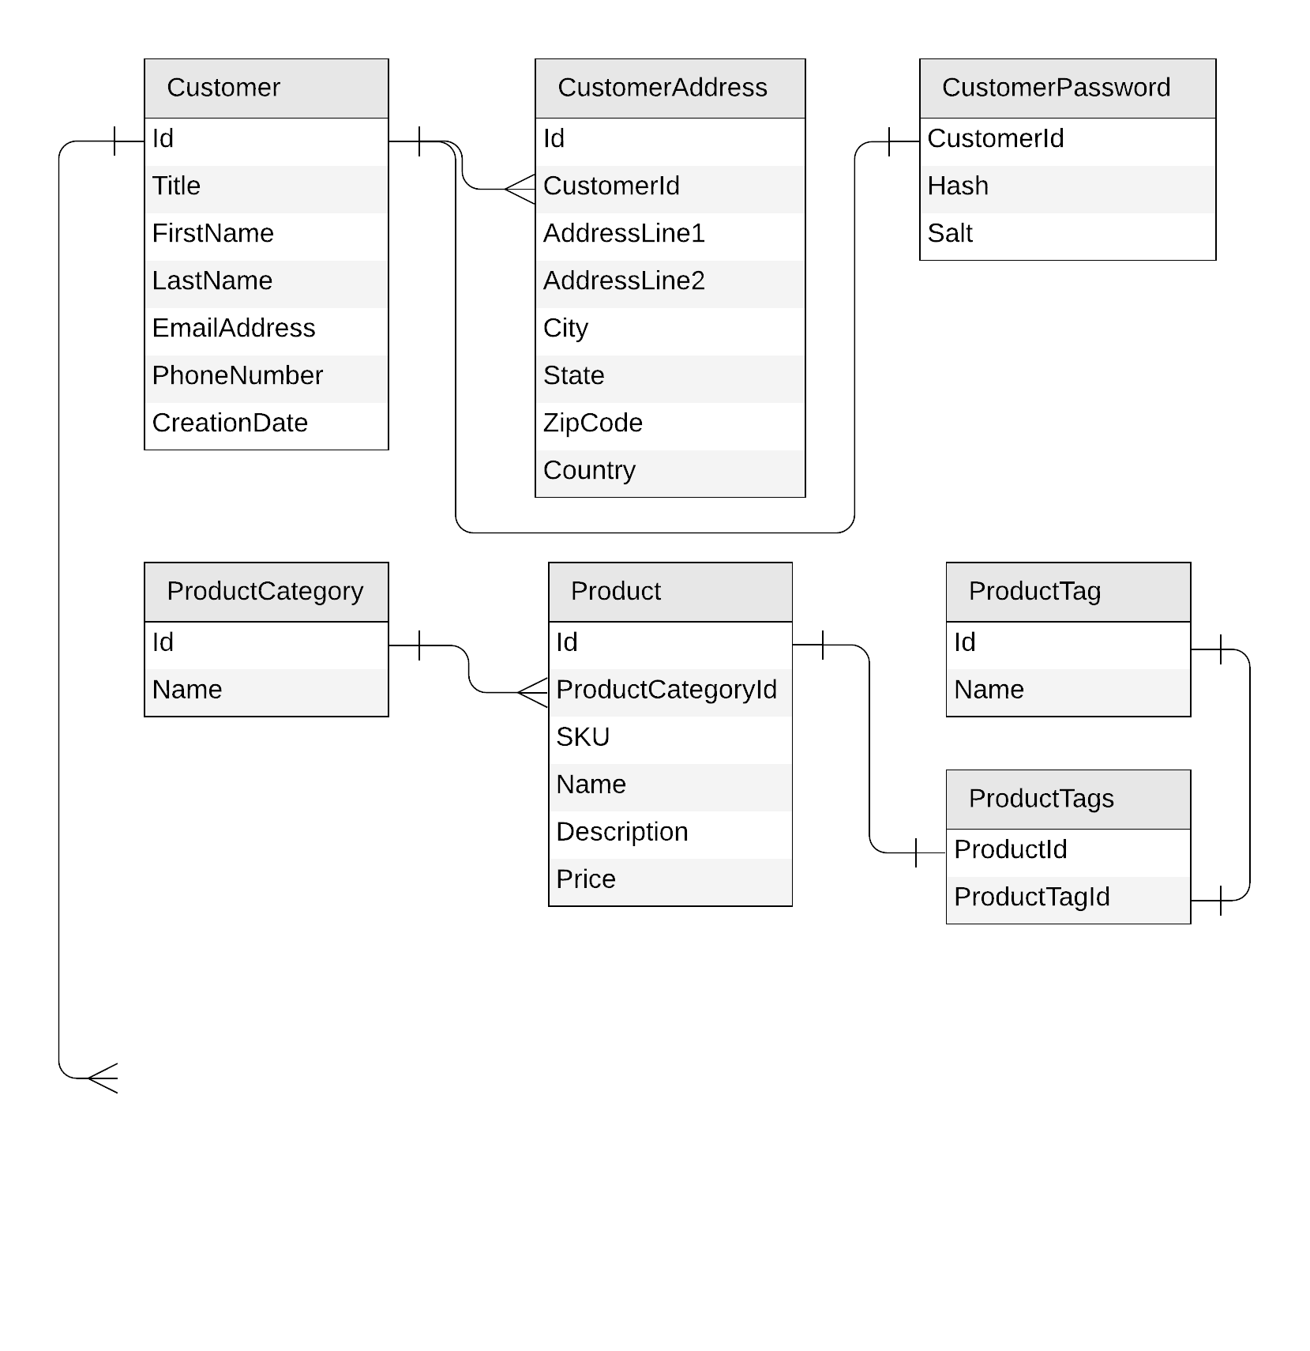
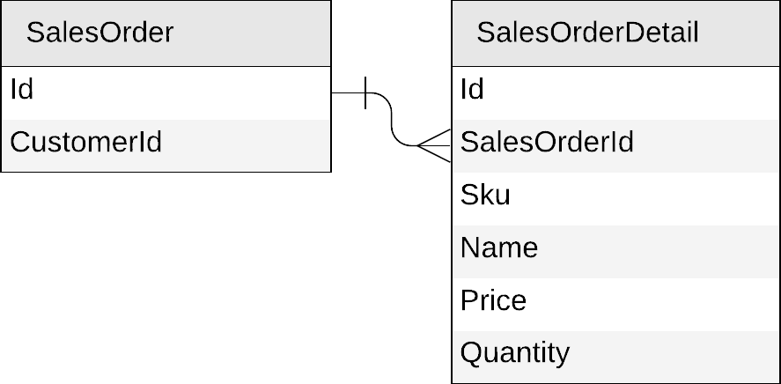
Next: sales orders

Slide 57
Sales orders
{
"id": "…",
"customerId": "…"
}
{
"id": "…",
"salesOrderId": "…",
"sku": "…",
"name": "…",
"description": "…",
"price": …,
"quantity": …
}

Slide 58
Sales orders
{
"id": "…",
"customerId": "…",
"details": [{
"sku": "…",
"name": "…",
"description": "…",
"price": …,
"quantity": …
}]
}

Slide 59
Sales orders
{
"id": "…",
"customerId": "…",
"details": [{
"sku": "…",
"name": "…",
"description": "…",
"price": …,
"quantity": …
}]
}
salesOrder
PK: ?

Slide 60
Sales orders
salesOrder
PK: ?
Create a sales order
List all sales orders for a customer
Query top 10 customers by number of sales orders

Slide 61
Sales orders
salesOrder
PK: ?
Create a sales order
List all sales orders for a customer
SELECT * FROM c WHERE c.customerId = 'CustomerA'
CustomerA
CustomerB
CustomerC

Slide 62
Sales orders
{
"id": "…",
"customerId": "…",
"details": [{
"sku": "…",
"name": "…",
"description": "…",
"price": …,
"quantity": …
}]
}
salesOrder
PK: customerId

Slide 63
Sales orders
{
"id": "…",
"customerId": "…",
"details": [{
"sku": "…",
"name": "…",
"description": "…",
"price": …,
"quantity": …
}]
}
salesOrder
PK: customerId
{
"id": "…",
"title": "…",
"firstName": "…",
"lastName": "…",
"emailAddress": "…",
"phoneNumber": "…",
…
}
customer
PK: id

Slide 64
Mixing entities in the same container?
YES!
Leverage the schema-agnostic nature of Cosmos DB
Suitable when different entity types
share similar access patterns
share the same partition key

Slide 65
Sales orders
{
"id": "…",
"customerId": "…",
"details": [{
"sku": "…",
"name": "…",
"description": "…",
"price": …,
"quantity": …
}]
}
salesOrder
PK: customerId
{
"id": "…",
"title": "…",
"firstName": "…",
"lastName": "…",
"emailAddress": "…",
"phoneNumber": "…",
…
}
customer
PK: id

Slide 66
Sales orders: mixing with customers
{
"id": "…",
"customerId": "…",
"details": [{
"sku": "…",
"name": "…",
"description": "…",
"price": …,
"quantity": …
}]
}
customer
PK: id
{
"id": "…",
"title": "…",
"firstName": "…",
"lastName": "…",
"emailAddress": "…",
"phoneNumber": "…",
…
}

Slide 67
Sales orders: mixing with customers
{
"id": "…",
"customerId": "…",
"details": [{
"sku": "…",
"name": "…",
"description": "…",
"price": …,
"quantity": …
}]
}
customer
PK: customerId
{
"id": "…",
"customerId": "…",
"title": "…",
"firstName": "…",
"lastName": "…",
"emailAddress": "…",
"phoneNumber": "…",
…
}

Slide 68
Sales orders: mixing with customers
{
"id": "…",
"type": "salesOrder",
"customerId": "…",
"details": [{
"sku": "…",
"name": "…",
"description": "…",
"price": …,
"quantity": …
}]
}
customer
PK: customerId
{
"id": "…",
"type": "customer",
"customerId": "…",
"title": "…",
"firstName": "…",
"lastName": "…",
"emailAddress": "…",
"phoneNumber": "…",
…
}

Slide 69
Sales orders: mixing with customers
customer
sales orders
customer
PK: customerId
CustomerA
CustomerB
CustomerC

Slide 70
Sales orders
customer
PK: customerId
Create a sales order
List all sales order for a customer
SELECT * FROM c WHERE c.customerId = 'CustomerA' AND c.type = 'salesOrder'

Slide 71
Demo
Query sales orders by customer id

Slide 72
Sales orders
customer
PK: customerId
Create a sales order
List all sales orders for a customer
Query top 10 customers by number of sales orders

Slide 73
Denormalizing the count of sales orders per customer
{
"id": "…",
"type": "customer",
"customerId": "…",
"title": "…",
"firstName": "…",
"lastName": "…",
"emailAddress": "…",
"phoneNumber": "…",
"creationDate": "…",
"addresses": [{
"addressLine1": "…",
"addressLine2": "…",
…
}],
"password": {
"hash": "…",
"salt": "…"
}
}

Slide 74
Denormalizing the count of sales orders per customer
{
"id": "…",
"type": "customer",
"customerId": "…",
"title": "…",
"firstName": "…",
"lastName": "…",
"emailAddress": "…",
"phoneNumber": "…",
"creationDate": "…",
"addresses": [{
"addressLine1": "…",
"addressLine2": "…",
…
}],
"password": {
"hash": "…",
"salt": "…"
},
"salesOrderCount": …
}

Slide 75
Denormalizing the count of sales orders per customer
customer
sales orders
customer
PK: customerId
CustomerA
CustomerB
CustomerC

Slide 76
Denormalizing the count of sales orders per customer
update the customer
add a sales order
customer
PK: customerId
CustomerA
CustomerB
CustomerC

Slide 77
Sales orders
customer
PK: customerId
Create a sales order
List all sales order for a customer
Query top 10 customers by number of sales orders
SELECT TOP 10 * FROM c WHERE c.type = 'customer'
ORDER BY c.salesOrderCount DESC

Slide 78
Demo
Create a new sales order & update total sales orders
Query for top 10 customers

Slide 79
Our final design
customer
PK: customerId
Customer
productTag
PK: type
ProductTag
SalesOrder
product
PK: categoryId
productCategory
PK: type
Product
ProductCategory

Slide 80
Our final design
productCategory
PK: type
ProductCategory
productMeta
PK: type
ProductTag
ProductCategory
productTag
PK: type
ProductTag
SELECT * FROM c WHERE c.type = ‘category'
SELECT * FROM c WHERE c.type = ‘tag'

Slide 81
Our final design, optimized!
customer
PK: customerId
Customer
SalesOrder
productMeta
PK: type
ProductTag
ProductCategory
product
PK: categoryId
Product

Slide 82
Key takeaways
Identify key access patterns and design for them
Partitioning is critical for best performance and scalability
Materialize relations between entities by:
Embedding
Denormalizing and pre-aggregating
Storing related entities in the same container
Different methods to implement denormalization
Using the change feed
Using stored procedures or transactional batch

Slide 83
Going further
github.com/AzureCosmosDB/CosmicWorks
Demos and links to sample data.
aka.ms/PracticalCosmosDB – model a blog platform.
youtube.com/azurecosmosdb – awesome videos
devblogs.microsoft.com/cosmosdb– our blog

Slide 84
End

